Slide 1
Gpp maintenance
Technical - Overview
Integration Team
July 2017

Slide 2
AGENDA
Overview
Service Overview
Maintenance Services Architecture
Services List
Message Format
Various Services
Sample

Slide 3
“
GPP enables bank to perform various SOD/EOD/Upload/Maintenance tasks via SOA essential for proper operation of application”
Fndt Message Format – Technical Guide

Slide 4



Maintenance overview
GPP
Processing Engine
UI
Maintenance Tasks
Maintenance Tasks
SOA/WS
APPROVAL
SOD
EOD
UPLOAD
CLEANUP

Slide 5

Services
Clean Deleted Entries
Advance Business Date
Delete From History
Move To History
Release from Schedule
Activate Matured Profile Changes
Apply Changes

Slide 6
TASKS SERVICE
<FndtHeader>
<credentials> general identifying attributes
<UserID> UserID for authorization
<Role> Role for supplied User
<RunTaskRequest> Task Service Request
<header>
<UserID> User for creating audit record
<taskID> ID of tasks to be executed
<record> Relevant required fields for completing action
<field> Field for given Task

Slide 7
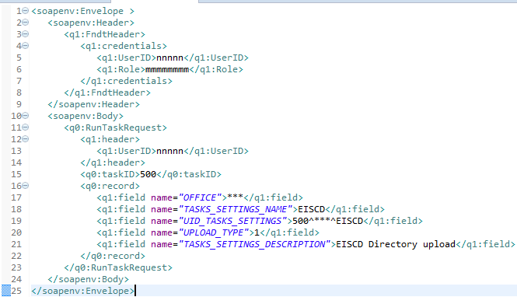
TASKS SERVICE- example
User Details
Task to be executed
Supporting informaiton

Slide 8
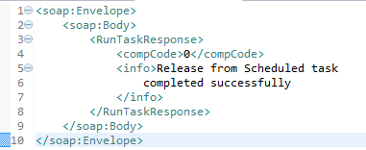
Tasks service response - Success
<RunTaskResponse> Task execution response
<compCode> Response code success/failure
<info> Additional information

Slide 9
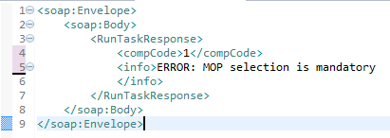
Tasks service response - failure
<RunTaskResponse> Task execution response
<compCode> Response code success/failure
<info> Additional information

Slide 10
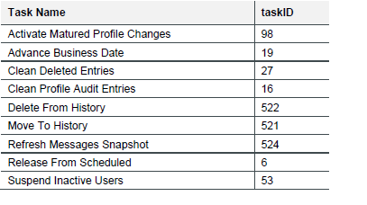
Task ids

Slide 11
Thank you
Rajesh Badiye
Integration Team
Rajesh.badiye@finastra.com

